Slide 1













Platinum Sponsors
Gold Sponsors
9•17•2022
Silver Sponsor
Swag Sponsor
Attendee Party Sponsor
Notes:
Give it to our sponsors!!!

Slide 2

Pretty, Pretty Power Apps
Agenda
Charles Lakes
Notes:
Beauty is in the eye of the beholder, so “pretty” is somewhat subjective, but still…
Build pretty apps:
Make screens more intuitive.
Improve UI and receive positive UX.
Give the app some personality. Be unique.
NO to the defaults… - April Dunam.
Why?
Shadow IT will buy something else.
Improve adoption. Can’t just make ppl use it.

Slide 3
Agenda
What is…
Cons of…
Pros of…
Prettying up…
Samples of…
Demo of…
Notes:
Note: Stop me if there are questions.
Why does design matter?
(1) UI/UX is still important: accessibility and usability
(2) Many companies have branding guides that dictate:
Colors, Iconography, Fonts, Whitespace,
Apps should still meet these guides.
Note, the brand guides should be available to everyone, wherever it may be:
Intranet, Shared drive, SharePoint Online, Box, Etc.

Slide 4

Power Apps
What is…
“Build powerful end-to-end business solutions…”
- Microsoft
Notes:
Brief introduction for those unfamiliar…
Part of the Power Platform:
Power BI
Power Automate
Power Virtual Agent
Power Apps
Of the collective, it’s the app builder of the suite.

Slide 5




Cons of Power Apps
Licensing
Power Fx
Low-code
Notes:
Using Power Apps isn’t free. There is a license cost for developers and users.
Anyone interacting w/ the app needs to be licensed.
Anyone interacting w/ the app needs access to the connector(s).
Also, Power Fx is still new-ish, so there’s a learning curve. Not everyone is comfortable w/ it.
- Many people want to stick w/ their tried-and-true languages, like C#.
Also, also, low-code may still require a bit of coding, depending on the complexity of the app.
- Many people want no-code solutions.

Slide 6
Pros of Power Apps
Licensing
Power Fx
Low-code
Notes:
The same things people consider cons, could also be pros.
- These are opportunities
People have to be licensed for Power Apps, but if third-party app are purchased, people would also need to be licensed.
License business users, then design and build business apps for w/o repeating costs for:
Laptop; Desktop; Mobile; Tablet;
Power Fx
Use existing Office skills w/ Excel-like formulas
Low-code
Fusion Teams
“Cross-functional” coalitions of citizen developers and pro developers.
Could be developers, marketing, and business users
Business users create the skeleton
Marketing polishes w/ branding
Developers/ admins connect data sources
Citizen Developers
Business users w/ a knack for logic and better understanding of the data than the developers.

Slide 7
Aesthetics
Prettying up…
Screens
Controls
Icons
Media
Themes
Colors
Fonts
Layering
Components
Notes:
Screens
- App > StartScreen property
Personalize w/ User()
Tweak overall screen size
Create consistent navigation
Specifying the exact color is key when there is a company brand guideline in place.
Kind of like the rich-text controls of Word
Specify app color and icon via settings screen.
Fonts
Where there isn’t a color guide, you can take advantage of the provided themes to spice up your screens all at once.
- Kind of like an Excel table theme
With the app colors specified, add shapes, icons, and other controls, then layer then to give the app a presentable screen.
- Kind of like PowerPoint
Example of controls,
Labels, Buttons, Text boxes,
Pictures, Date forms, Icons,
Etc.
Controls can be grouped
Controls have “properties”:
- X, Y, OnSelect, Text,
Colors
Foreground
Background/ Fill
Borders
Hover
Word formatting
E.g., rich-text editing
Bold,
Italic,
Font families
Components
Create consistency
Create scalability w/ reusable elements
Create collections of components
Specify users and co-owners

Slide 8

Aesthetics
Samples of…
Screens
Controls
Icons
Media
Themes
Colors
Fonts
Layering
Components

Slide 9
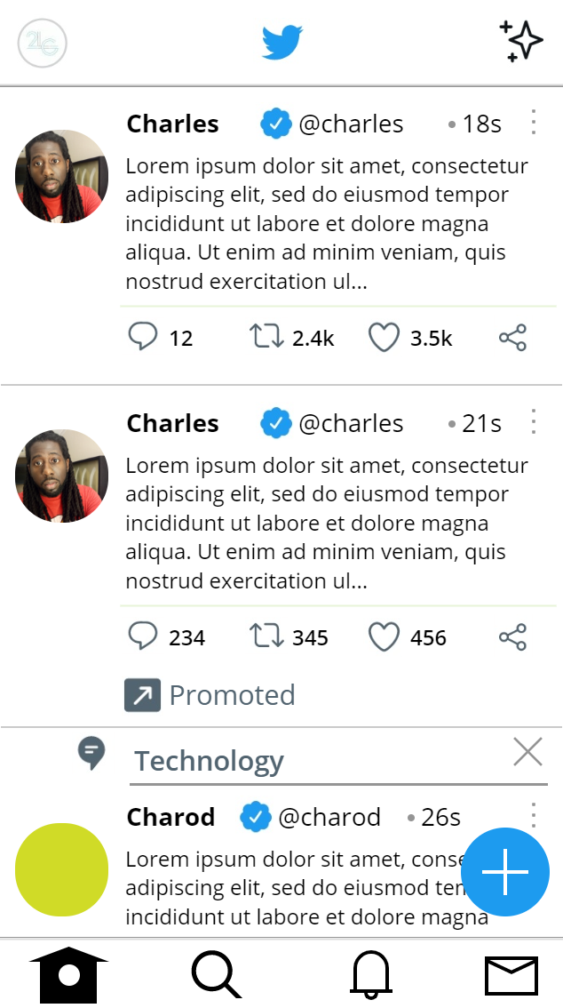
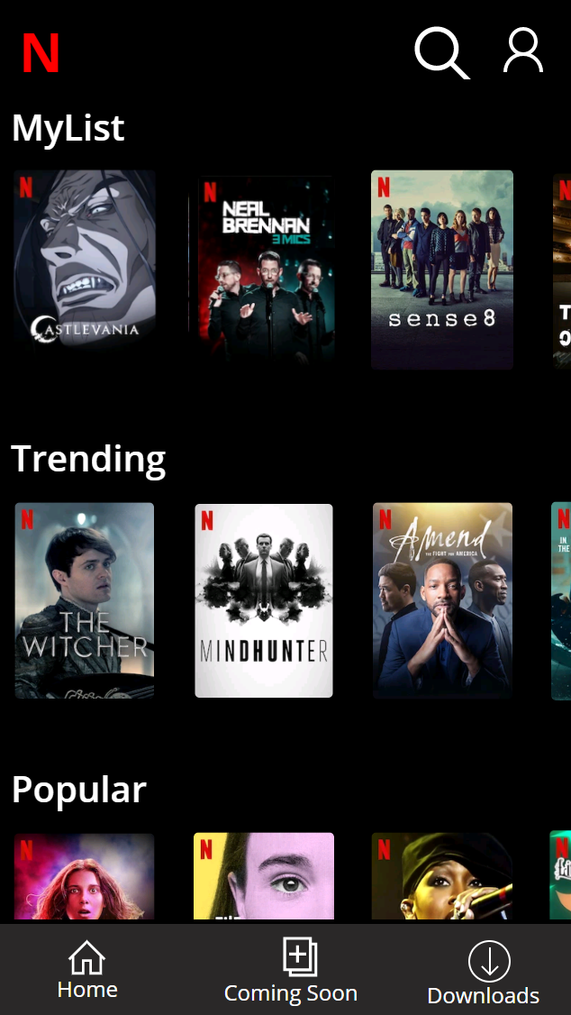
Sample #1
Samples of…
Notes:
App Controls:
Flexible height gallery
Content Scroll
Component
Header
Footer
Media
Profile images
Header logo
Text
Labels
HTML Text
Icons
Footer

Slide 10
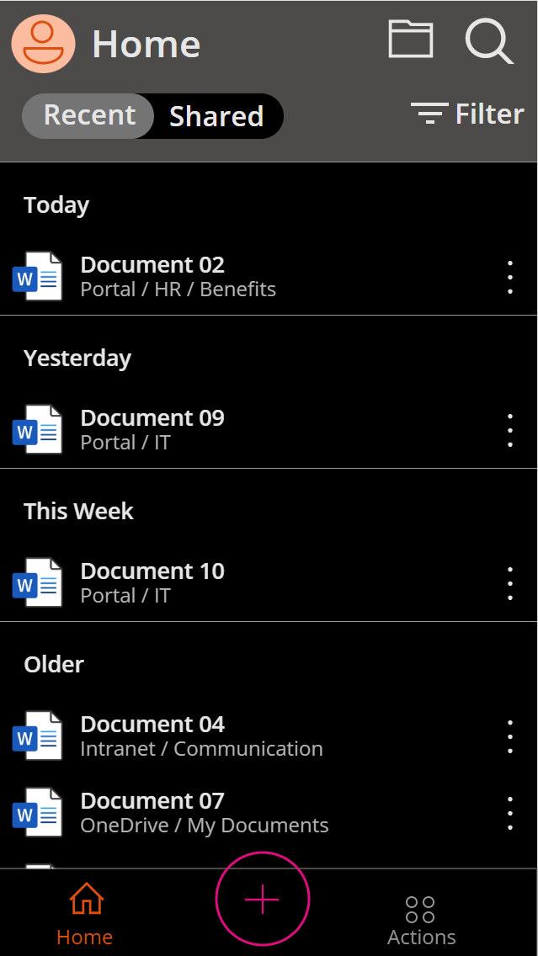
Sample #2
Notes:
App Controls:
Nested galleries
Vertical scroll - Categories
Horizontal scroll – Category Titles
Component
Footer
Media
Title cover images
Text
Labels
Icons
Footer is a square icon
“Downloads” is two layered icons
Header search
Header profile

Slide 11
Sample #3
Notes:
App Controls:
Vertical gallery bound to customized collection
Media
Document icons
Icons
Icons and labels grouped.
Actions is just several circles grouped
Profile is just several circles and squares layered

Slide 12
Aesthetics
Demo of…
Screens
Controls
Icons
Media
Themes
Colors
Layering
Components
Etc.

Slide 13

Contact
CharlesLakes.com
Thank you for attending!
Notes:
Additional resource, check out April Dunnam!
- https:/github.com/aprildunnam

